Slide 1
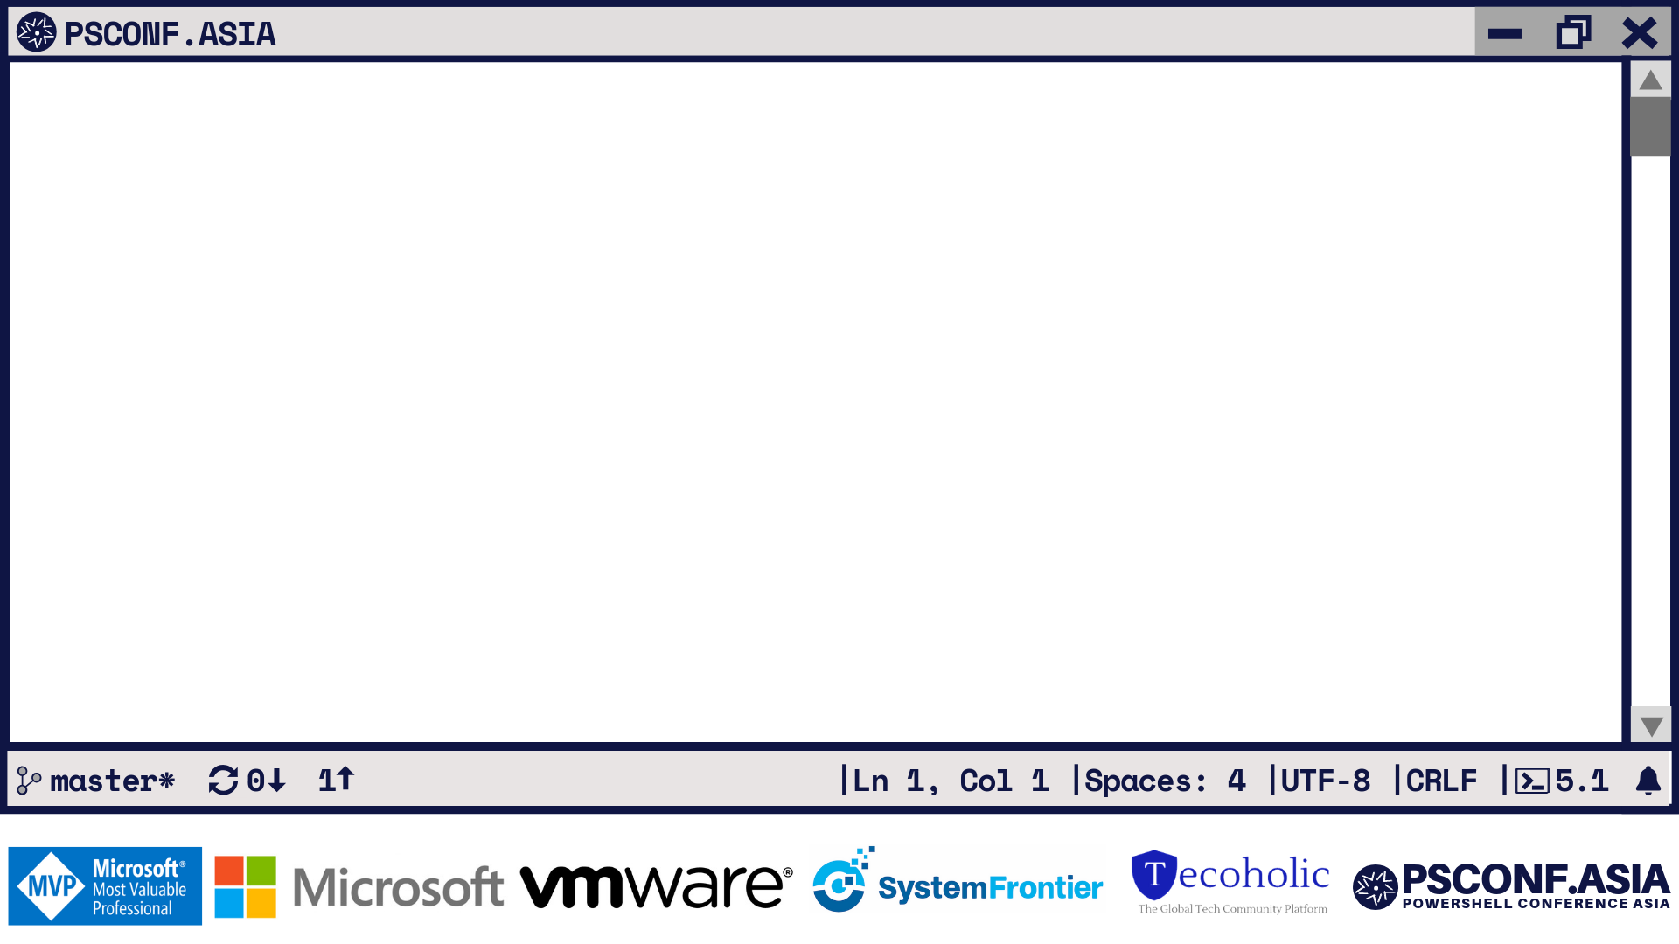
Cross-Platform Scripting
With VSCode and PSScriptAnalyzer
Rob Holt Software Engineer, PowerShell Team
LF
7.0

Slide 2
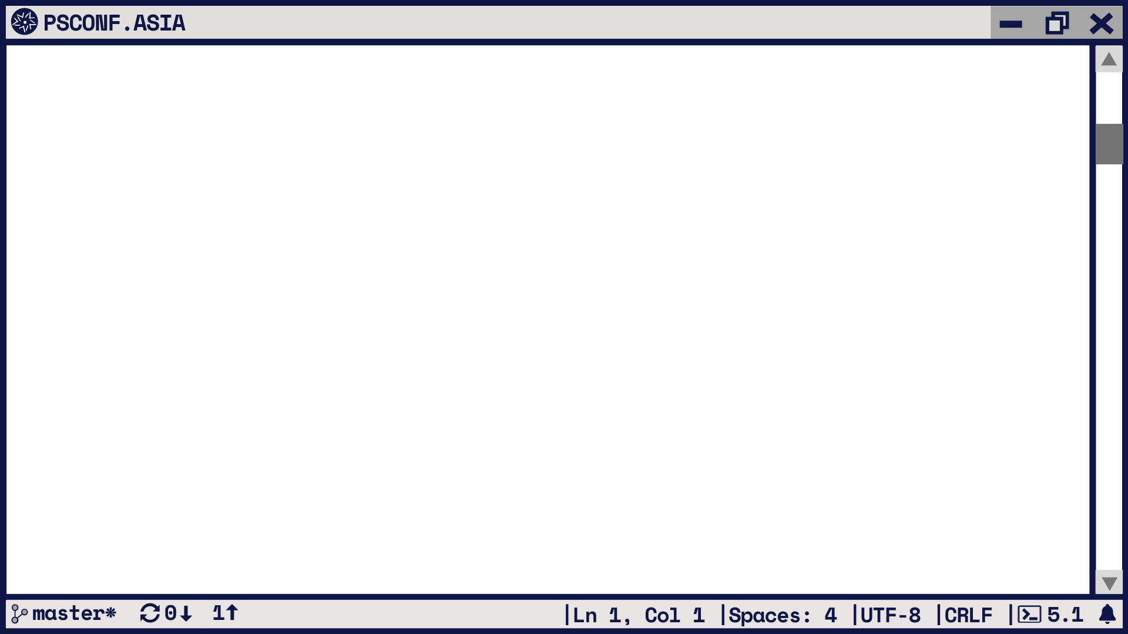
Multiple PowerShells, Multiple Platforms
PowerShell 3, 4, 5.1, 6.2, 7 all in use today
PowerShell 6+ supports multiple operating systems
PowerShell scripts deployed to different OSes, different PS versions
Modules
PSScriptAnalyzer, PowerShellEditorServices, Pester
LF
7.0
Notes:
PowerShell in multiple versions is in use today
Since PowerShell 6, PowerShell is not OS-specific
Available on Windows Client/Server/IoT, macOS, Linux – Ubuntu, Debian, RedHat, CentOS, Fedora, Alpine, Raspberry Pi
Xplat applications use PowerShell under the hood and need it to work where they do
Many platform-specific PowerShell applications still need to work with common modules – these must support large numbers of platforms

Slide 3
Cross-platform Strategies
One script per platform
Code duplication, still need an entry point
Combinatorics are bad (OS x PS version x other stuff?)
(Re)write code to be more general
Apply a few general tips: encoding, casing, paths, environment
Tool it!
LF
7.0
Notes:
Can try to write one script per platform
But most of the code will probably do the same thing
And usually needs to start from a common entry point/call anyway
Platforms aren’t as simple as PowerShell version and OS
Combination of PS, OS, .NET version, installed features, modules, etc.
So instead, strategy is to write code that uses PS and .NET abstractions
Can deviate with logic for specific platform needs
Some general strategies for this
But also there are tools that can help with it, especially all the small bits

Slide 4
VSCode + PSScriptAnalyzer
VSCode
Cross-platform editor: works where PowerShell does
Excellent support beyond PowerShell
Remove development extensions
PowerShell extension
IDE features for PowerShell in VSCode
PSScriptAnalyzer
Static analysis
Helps enforce portability and generality in scripts
LF
7.0
Notes:
Choice of editor is important and there are a number of options
But going to talk about VSCode because
It’s very cross-platform and works in all the places PowerShell does
It has excellent support for more than PowerShell
Declarative config languages like JSON, XML, YAML
Also other tools, like C#, Python
Recently added remote extension support for working from one machine on another – totally separate from PowerShell remoting
The PowerShell extension adds PowerShell IDE support
Completions, debugging, integrated console
Recently released a new version
PSScriptAnalyzer provides linting
Powerful tool for cross-platform script
Prevents bad habits
Encourages portable PowerShell usage
Cross compatibility rules recently introduced in 1.18
Designed specifically to help author PowerShell targeting different platforms
Will show more on this shortly

Slide 5
Public Service Announcement: Encoding
VSCode PS extension can switch between in-box PowerShells
Also can manipulate file encoding (how characters are saved to bytes)
Demo: Invoke-Command –ScriptBlock { "Hello" }
Windows PowerShell guesses older, less portable encoding
Pick the encoding most suited for your platforms
Usually UTF-8 with BOM
PSScriptAnalyzer: PSUseBOMForUnicodeEncodedFile
Easy to set in VSCode (also Notepad)
Beware of ISE, clipboard, shared code, source control, colleagues
LF
7.0
Notes:
Innocent looking command, runs fine in PS 6+, but problems in PS 5
Show running in PS 7 and then PS 5
Command is ASCII until dash, then UTF-8
Windows PowerShell guesses CP-1252 / latin-1
Old behaviour needed to be changed because language specific
Fix with a BOM, PowerShell sees this and knows UTF-8
Not a perfect solution – Linux utilities don’t like it as much
VSCode makes setting and opening files in encoding easy
Notepad can do this too
ISE does not configure this easily at all, although it’s possible
Has a tendency to resave files
Clipboard in Windows also does some mangling, e.g. copying over RDP or Hyper-V
If you share code, beware of editors that quietly change encoding back
Source control makes this look like a huge diff where nothing has changed

Slide 6
Using PSScriptAnalyzer for cross-compatibility
Ordinary PowerShell module: Invoke-ScriptAnalyzer
Reads tokens/AST of PowerShell to analyse usage
Integrates with VSCode PS extension
Includes a number of default rules which are helpful
Get-ScriptAnalyzerRule to provide rules + info
Some rules that require configuration (can’t be default)
Cross-compatibility rules from 1.18!
LF
7.0

Slide 7
Cross-compatibility rules in PSSA
UseCompatibleCommands: Catch commands/parameters
Get-WMIObject, Restart-Service, Import-Module –FullyQualifiedName
UseCompatibleTypes: Catch types/static methods
[WildcardPattern], [LanguagePrimitives]::ConvertTypeNameToPSTypeName()
UseCompatibleSyntax: Catch version-incompatible syntax
[type]::new(), [type]::$dynamicName, using, workflow
Documentation is your friend!
https://github.com/PowerShell/PSScriptAnalyzer/blob/master/RuleDocumentation/UseCompatibleCommands.md
LF
7.0

Slide 8
Porting a Windows PowerShell script
Have a Windows PowerShell script that works with 5.1
Start by porting it to PS 6 on Windows
Begin with Invoke-ScriptAnalyzer and UseCompatibleCommands
Integrate with PS extension for VSCode
Then try PS 6 on Ubuntu 18.04
Finally, let’s also port it to PS 4
LF
7.0

Slide 9
More than just the default profiles
Other profiles exist at https://github.com/PowerShell/PSScriptAnalyzer/tree/master/PSCompatibilityCollector/optional_profiles
Target RHEL or macOS
Generate your own with PSCompatibilityCollector
Plan to improve target availability and specification experience
Download from a remote repository
Get past clunky names!
LF
7.0

Slide 10
How does it work?
Magic
Store a big dump of JSON
Build a common profile (everything from any profile)
Look for things not in a target but in the common profile
Can manipulate with PSCompatibilityCollector module
Build your own! Plan to publish to PSGallery soon
https://github.com/PowerShell/PSScriptAnalyzer/tree/master/PSCompatibilityCollector
LF
7.0

Slide 11
Summary
VSCode has tooling to help cross-plat scripting
PSScriptAnalyzer default rules also help
Cross-compatibility rules really come into play
Rules aren’t all-powerful, but they find hidden traps before executing
Plenty of tricks we could add – help us
LF
7.0

